Slide 1
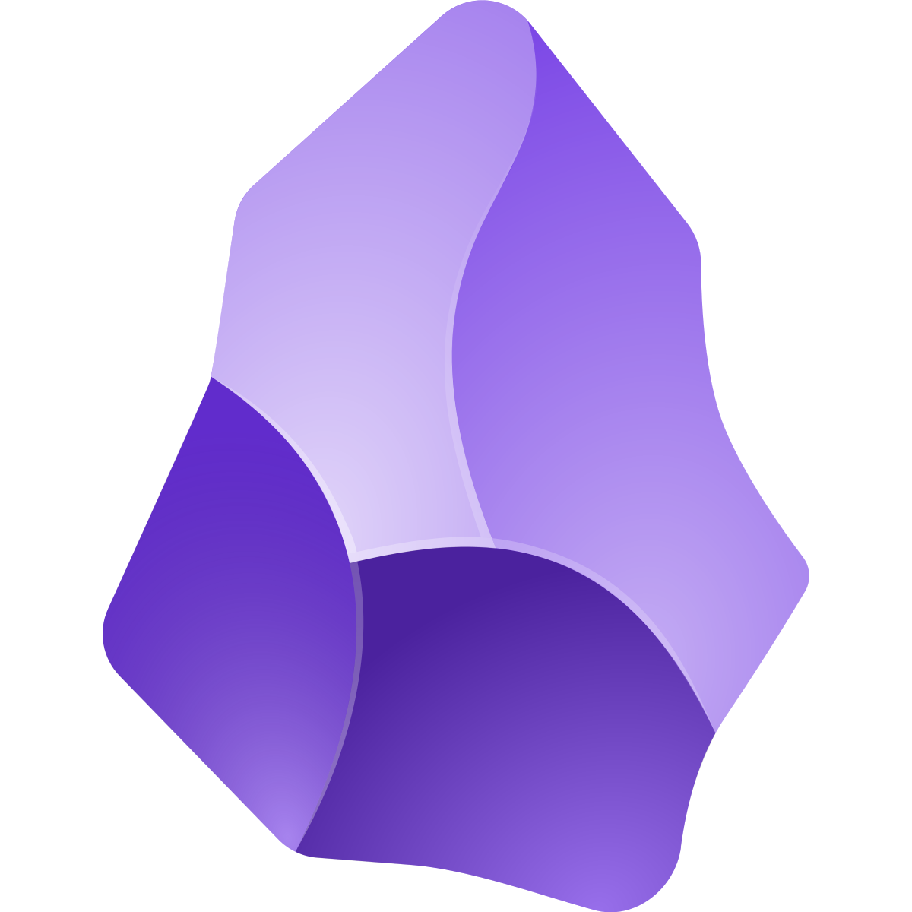
Obsidian
Aidan Honor September 24, 2025

Slide 2
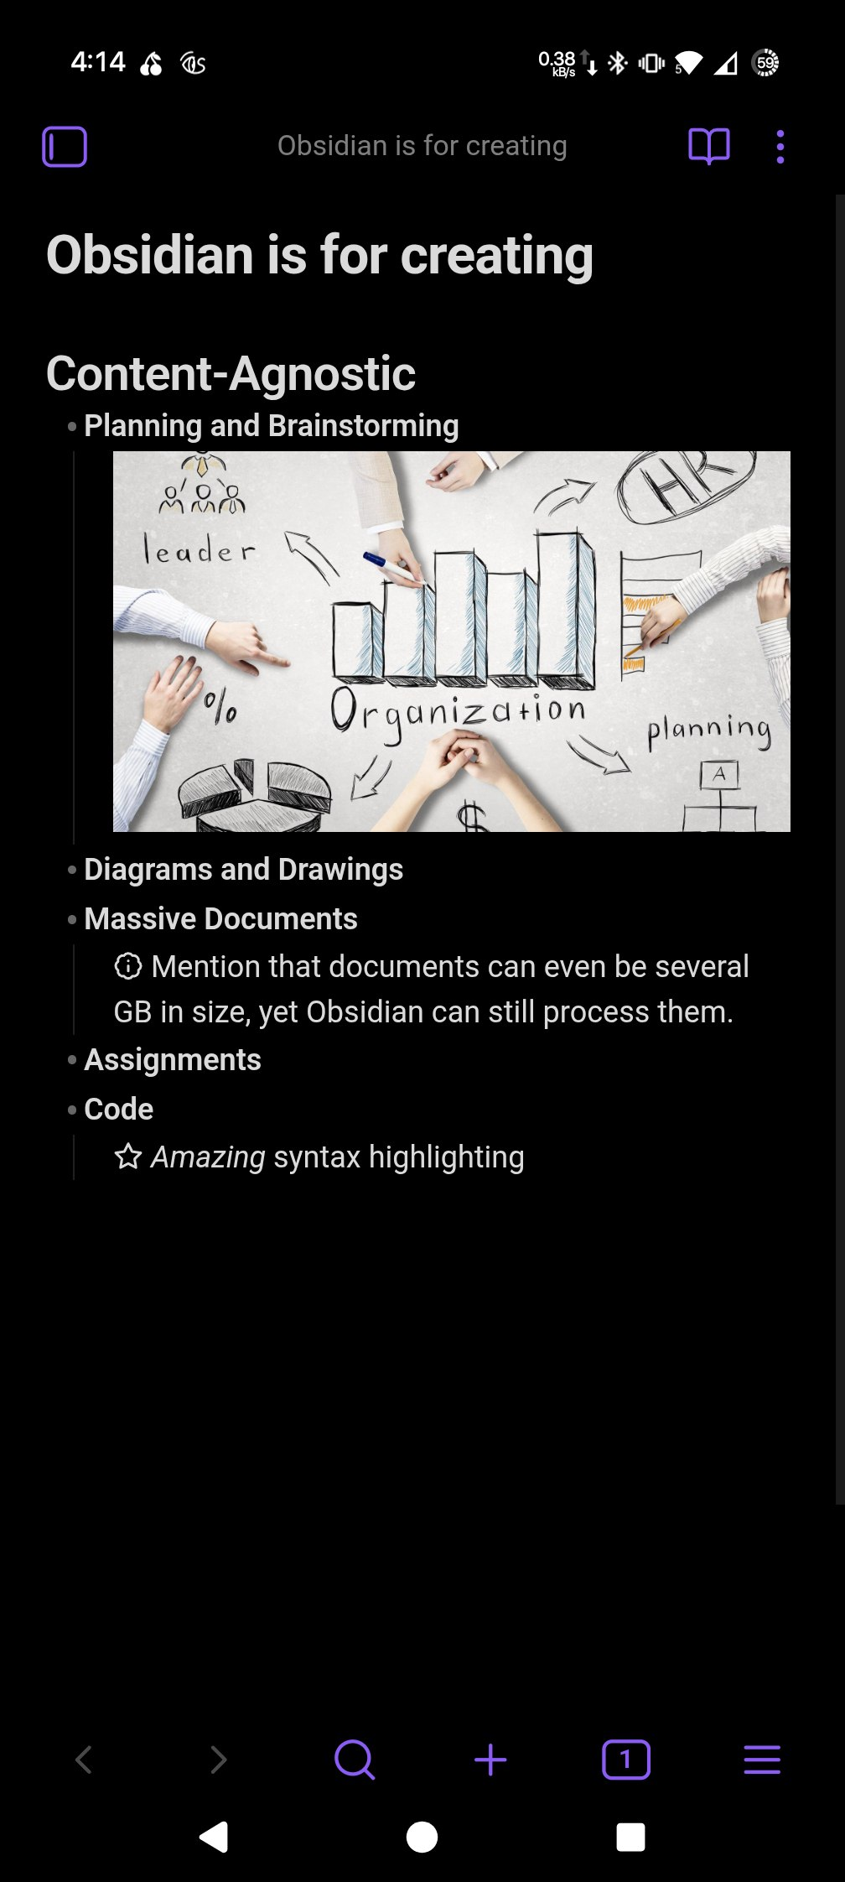





Obsidian is for creating.
Content-agnostic
Planning and Brainstorming
Diagrams and Drawings
Massive Documents
Assignments
Code

Slide 3

Obsidian is Markdown
Save space, time, and sanity.
Did you know?
Files created with Microsoft Word (in formats such as .docx) can be up to 30x larger for the same content? Shorter Word files tend to create a worse size-to-content ratio.
18,000
+
10
4.45
MB
=
words
attachments

Slide 4
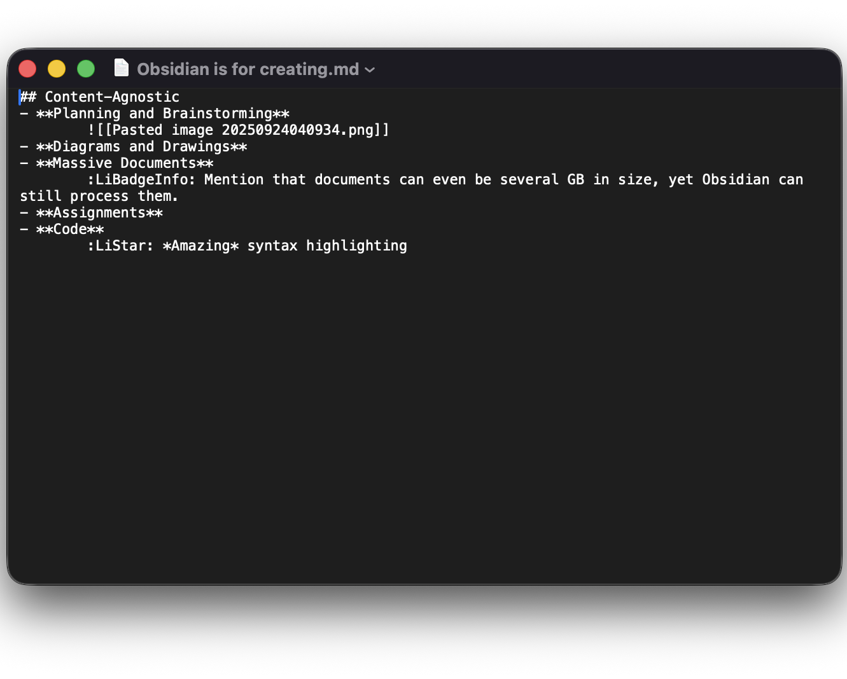

Obsidian is Markdown

Slide 5
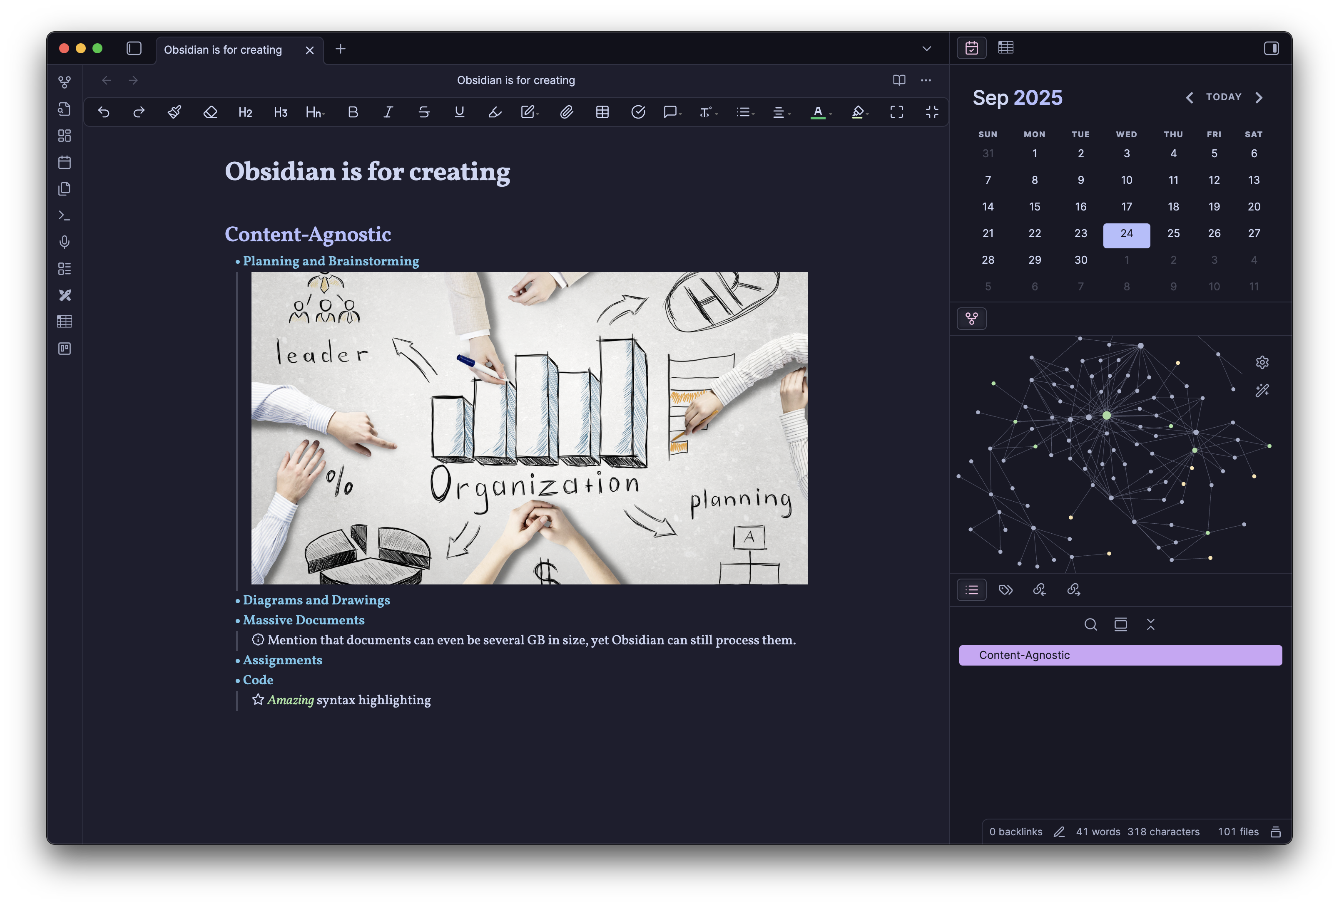
Obsidian is documents, done my way

Slide 6
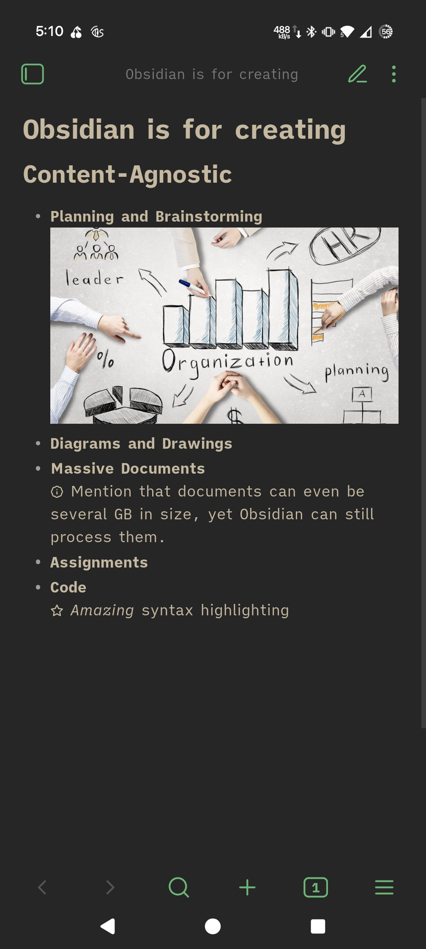
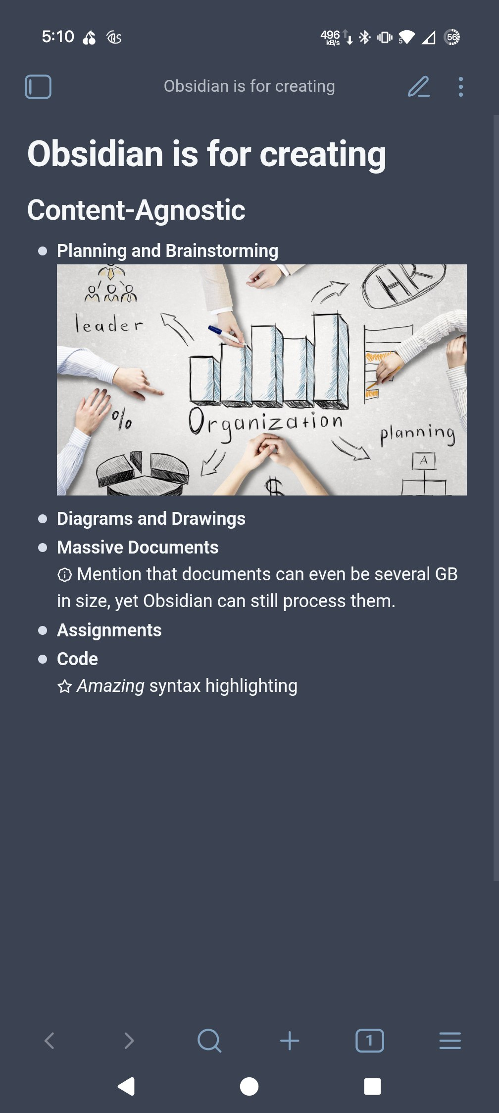
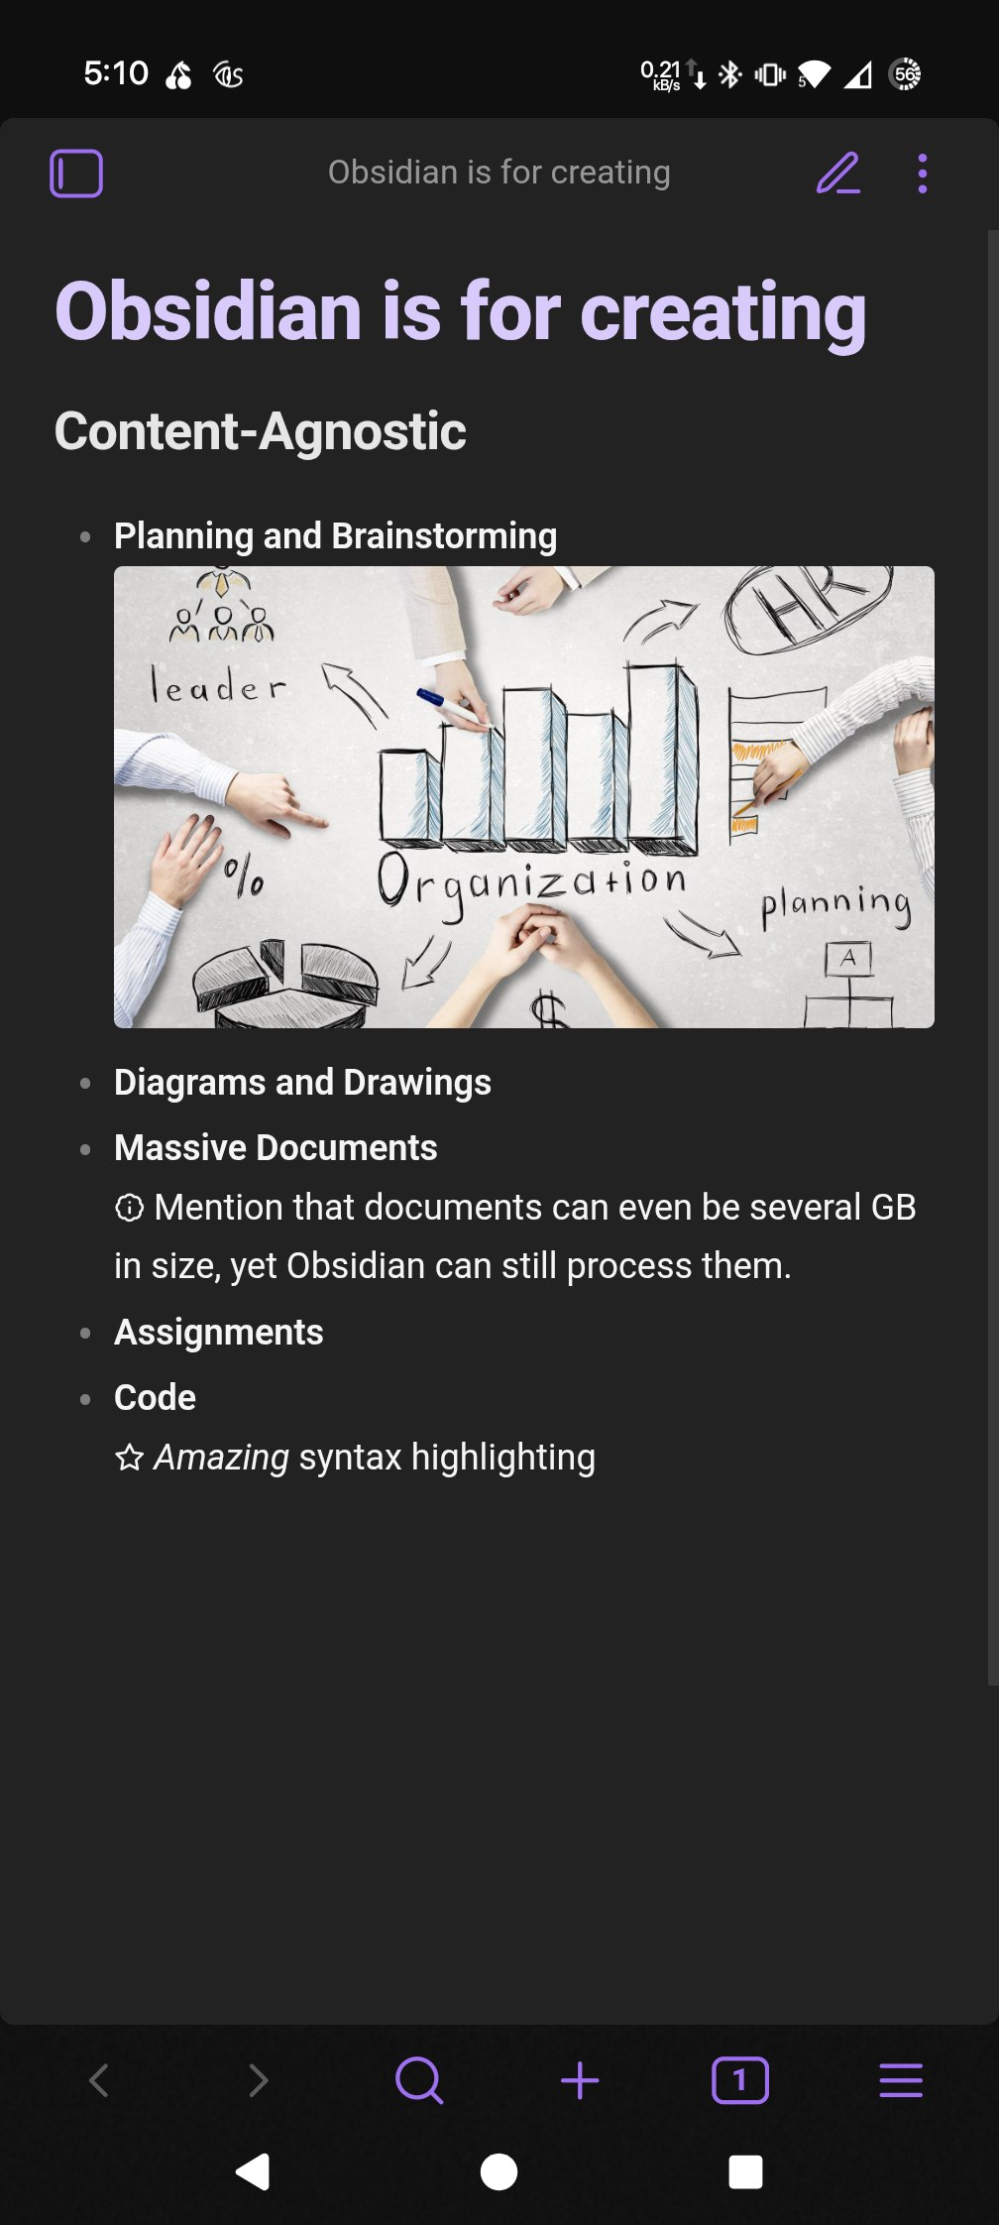
…and their way

Slide 7
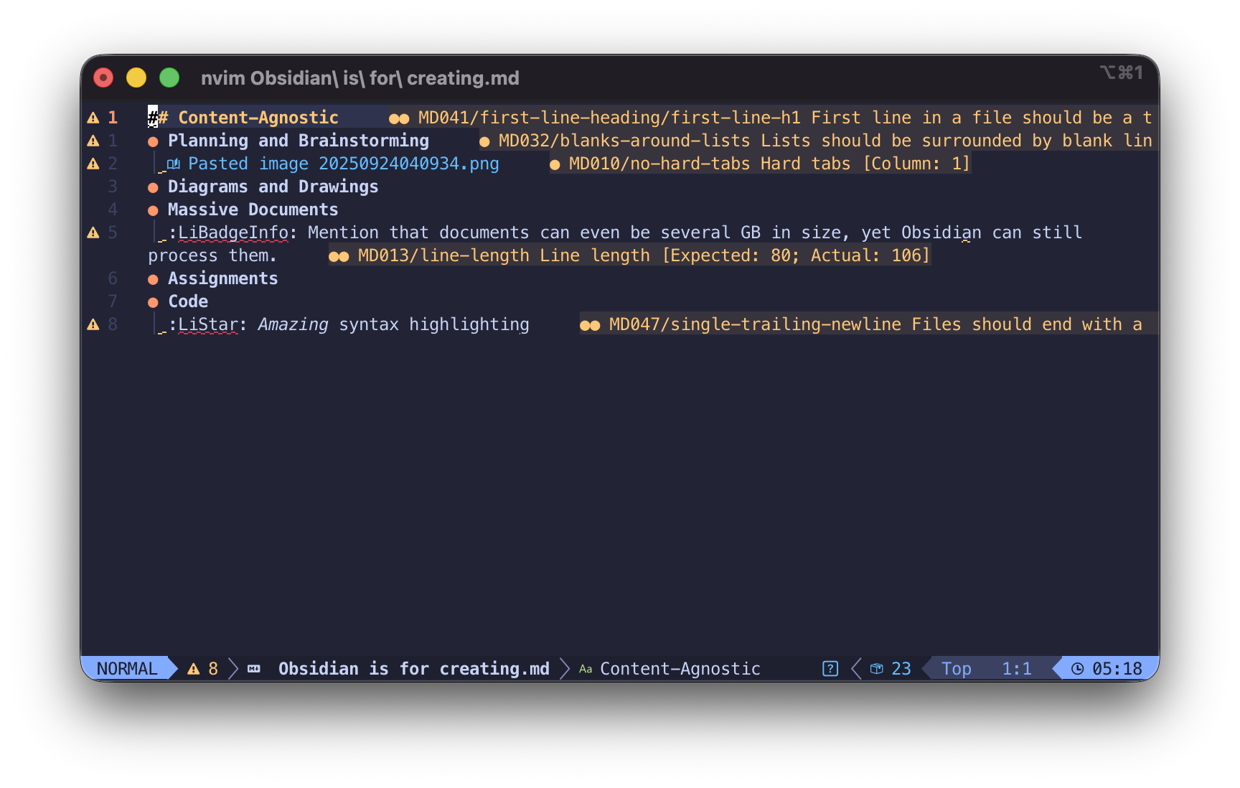



…and every way
But, that’s not all!

Slide 8
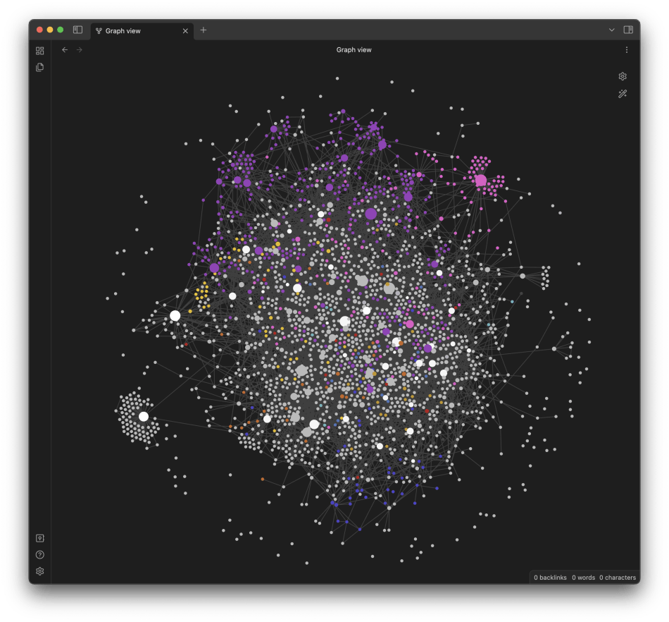
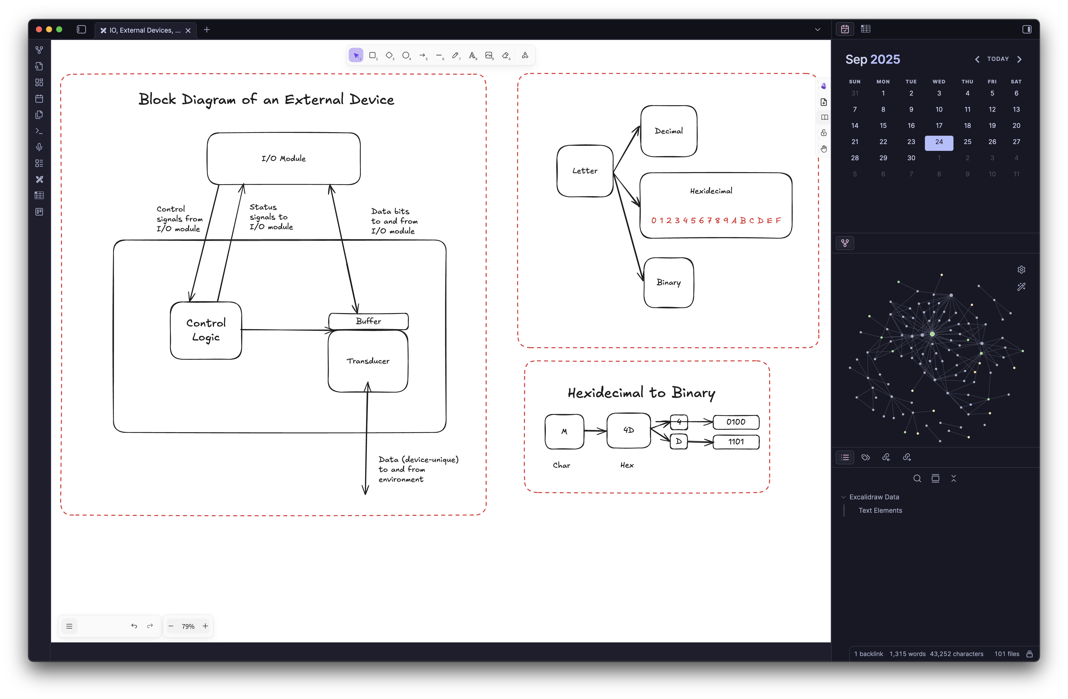
Obsidian is
Plugins for Obsidian
VERY
Extensible
Graph View (built-in)
Excalidraw for Obsidian
2600+
370+
plugins
themes

Slide 9
And the best part… it’s free!
The files made by Obsidian are in a format you can use in other apps and programs, meaning you don’t get locked into one app.
Obsidian also offers a paid syncing subscription for $3-10 per month, allowing for extra convenience.
The cloud storage you (likely) already pay for works just the same, and the documents aren’t locked into the Obsidian app or service.
Did you know?
Microsoft makes money by locking users into expensive subscriptions using this technique. By creating proprietary formats for documents, it makes it harder for people to use the documents outside of a Microsoft product. Using Obsidian for documents can not only save you time, but also money and stress.

Slide 10





Download today!
iOS
Ubuntu
Android
Windows 11
macOS
Debian-based
Windows 10
Flatpak
https://obsidian.md/

